Slide 1

Georgia College Advising Corps
Student Essays and Recommendation Letters
Liz Phillips, UGA Assistant Director of Admissions

Slide 2

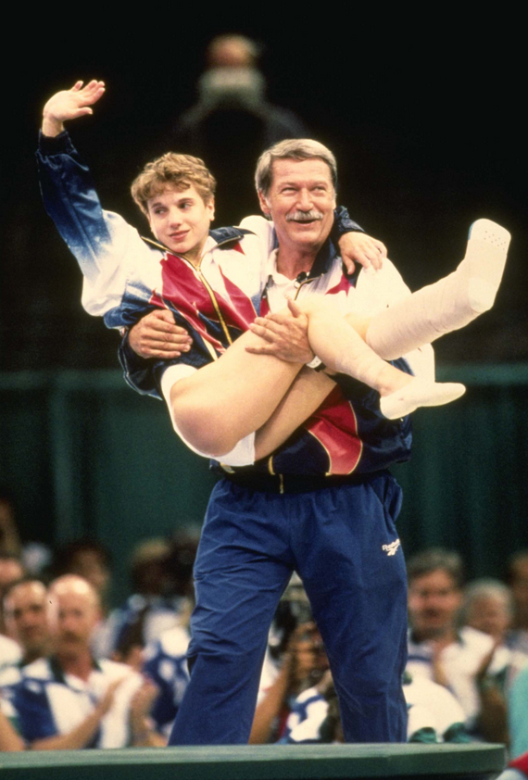
Student Essays
UGA Counselor Perspective
Overused Topics
Mission Trips / Travel Abroad*
Feeding the homeless*
Game winning sports injury*
Parents' divorce*
Grandparent death*
Baby stories
Cringe-Worthy
Incorrect spelling or poor grammar
Not answering the question
Gross/vile language
Negative tone
Listing everyone in their family that attended UGA
Lifelong history of cheering on UGA football
Spellcheck as a proofreader
Overuse of a thesaurus

Slide 3
Student Essays
2014 UGA First-year Application Essays
Choose an intellectual or creative opportunity (for example, community involvement, a summer program, a unique project, travel abroad, etc.) from your high school years that you have enjoyed and highlight how you have grown personally because of the experience.
It has been said that every friend and acquaintance with whom you share your life can become, in ways small or large, a part of who you are. Briefly tell us about one such person—not a relative—who many people would say is quite different from you. Use only her or his first name, and in particular, reflect on your interactions and how those experiences may have changed you.
Tell us an interesting or amusing story about yourself that you have not already shared in your application.
UGA’s First Year Odyssey Program offers more than 300 seminar courses for new freshmen. Some examples include “The History of Horseracing”, “Einstein and the Theories of Relativity” and “The Zombie Plague”. If you could create your own seminar course at UGA in any subject area that interested you, what would it be? What would the course be named and what would you hope to learn?
Start Early
Interview others
Research
Practice / Free
Write and rewrite
Avoid duplicating info
Throw away the thesaurus
Be creative
Be yourself
Don't over-philosophize
Get a 2nd opinion
PROOFREAD

Slide 4
Essay #1
While overseas in Europe studying the History of the Holocaust, my classmates and I were touring the streets of Europe when my friend needed to make a withdrawal to purchase a souvenir for his family. Walking up to a currency exchange kiosk, the man charged double the amount needed to change the currency from American dollars to Prague crowns. Using my critical thinking skills, I decided to travel, with the class, to a currency exchange unit inside an airport. These are commonly known as the most reliable exchange kiosks in Europe. I urged my peers to exchange all their currency to eliminate the need to stop at risky shops to exchange. No other stories of problematic exchange methods have been told sine. Using my problem solving skills, the trip became much more enjoyable and comfortable due to the elimination in risky currency exchange.
Essay #2
Hot, sticky air clung to my skin. Two little pairs of dirt-caked hands mercilessly pulled at my hair, fashioning sloppy braids. After trying unsuccessfully to communicate the pain my young stylists were inflicting, I decided to relish the remaining hours I had with these precious girls instead. During the nine days of my Dominican Republic mission trip, the three of us had bonded and become fast friends. The most effective Spanish teachers I have ever had, these tiny professors ushered me into a new realm of understanding, stretching me beyond my comfort zone. Immersed in a world without English, I was forced to take my 8+ years of classroom Spanish into the real world; my faithful little tutors never left my side.

Slide 5



Teacher Recommendations
UGA Teacher Recommendation Form
Make sure the student has applied
Junior or Senior year teachers
Teachers from academic classroom
1 to 2 recommendation letters
Classroom setting
Add a copy of resume to teachers

Slide 6
Resources
Adjectives and Phrases
  https://docs.google.com/a/rutgersprep.org/document/d/1EtJTFivkKfxLDS3XzImYadAQIKX9Xy4hcKg6oAyXss8/edit?hl=en_US&ndplr=1&pli=1
5 principles for effective letters
  http://chronicle.com/blogs/profhacker/reader-response-roundup-5-principles-for-writing-effective-letters-of-recommendation-for-grad-school-applicants/29621
Request for rec letters
  http://georgehwilliams.pbworks.com/w/page/14266825/Letters%20of%20recommendation
How to write good letter:
  http://chronicle.com/article/How-to-Write-a-Good/45944/
Hamilton.edu
  http://www.hamilton.edu/admission/counselors/hamilton-tips-for-writing-college-letters-of-recommendation
MIT
  http://mitadmissions.org/apply/prepare/writingrecs
WACAC info:
  http://wacac.org/hstool
NACAC student essay writing tips
  http://www.nacacnet.org/studentinfo/articles/Pages/Top-Ten-Tips-for-Writing-a-College-Essay-.aspx
2012 NACAC presentation: Why Good Students Write Bad Essays
  http://www.nacacnet.org/events/2012/session-archives/Documents/2008%20Documents/C306.pdf
College Essay Advisors
  http://www.collegeessayadvisors.com/portfolio-items/the-state-of-admissions-in-2013/

